Slide 1
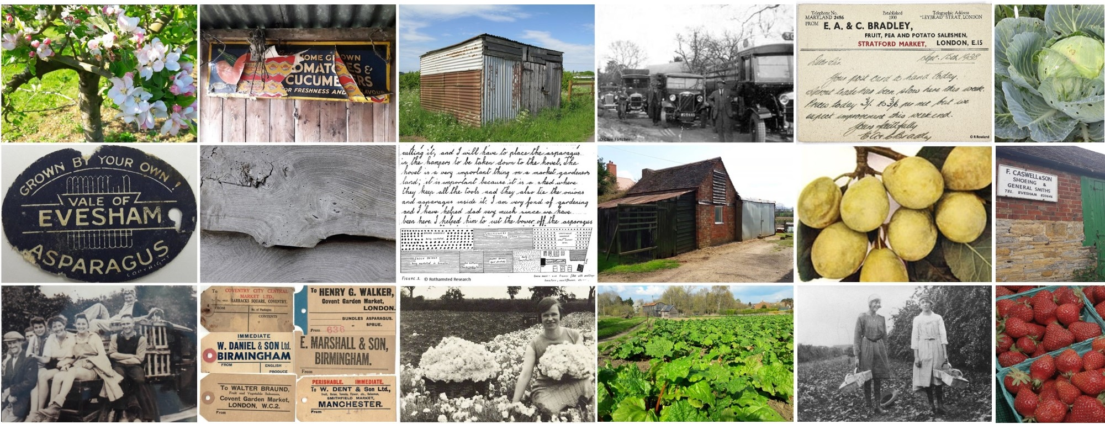
Market Gardening
in the Vale of Evesham
Notes:
A brief introduction to market gardening in the Vale of Evesham, southeast Worcestershire.
Part of the Market Gardening School Resource Pack created in 2020 by Worcestershire Archive & Archaeology Service.

Slide 2
Why is market gardening important?
Key local industry and a way of life for many families from the mid-19th to mid-20th centuries.
Vale of Evesham was, in the past, one of the largest areas for growing fruit and vegetables in the country.
Notes:
Image: Rhubarb growing in Badsey with a small wooden hovel (market gardener’s shed) in the background, with larger barn behind (2019).

Slide 3
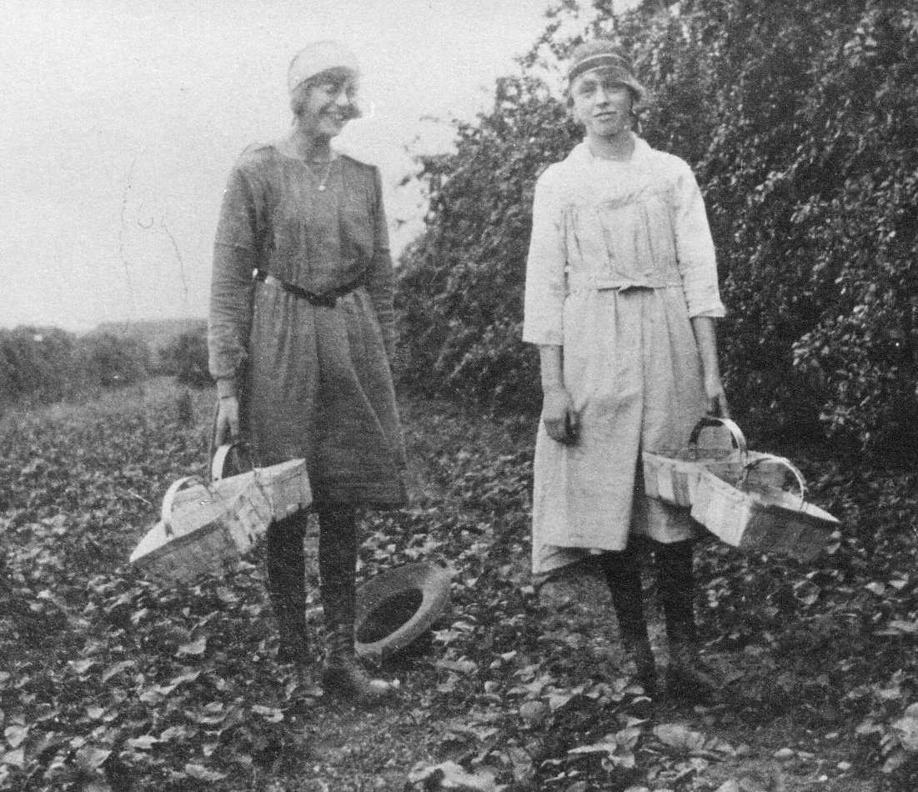
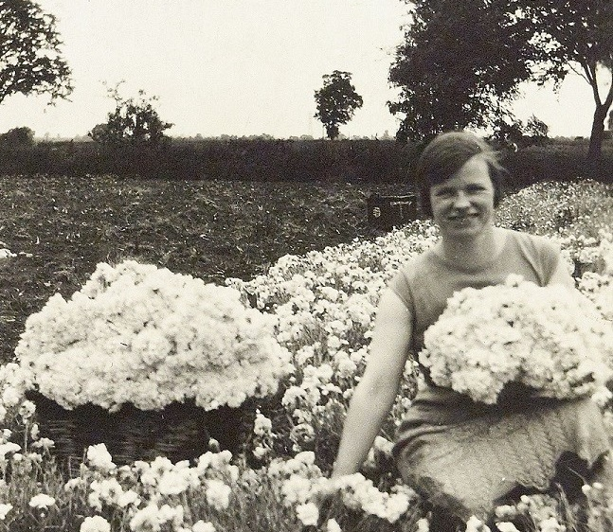
What exactly is market gardening?
Growing a wide range of fruit, vegetables, herbs and flowers to sell.
On a market garden, lots of crops are grown at once.
© M. Izod
© M. Izod
Not just plums and asparagus!
© I. Pullin
Notes:
Whilst market gardens do looked a bit like large allotments, in the sense that they were densely packed with a range of crops, allotments are grown for your own consumption, whilst market gardens are growing for market.
Images – Top: Strawberry picking in Fladbury (1920s) ; Middle: Produce loaded for market (1930s); Bottom: Picking pinks to sell, Bretforton (1930s)

Slide 4
Plums, strawberries, raspberries, gooseberries, cherries, currants, apples, pears, rhubarb, onions, spring onions, radishes, beans, peas, sprouts, marrows, asparagus, turnips, cauliflowers, tomatoes, wallflowers (gillies), daffodils, pinks, cornflowers, lettuce, parsley, sage, medicinal herbs and more.
Notes:
This isn’t an exhaustive list, but it nicely illustrates the range of crops grown by market gardeners.

Slide 5
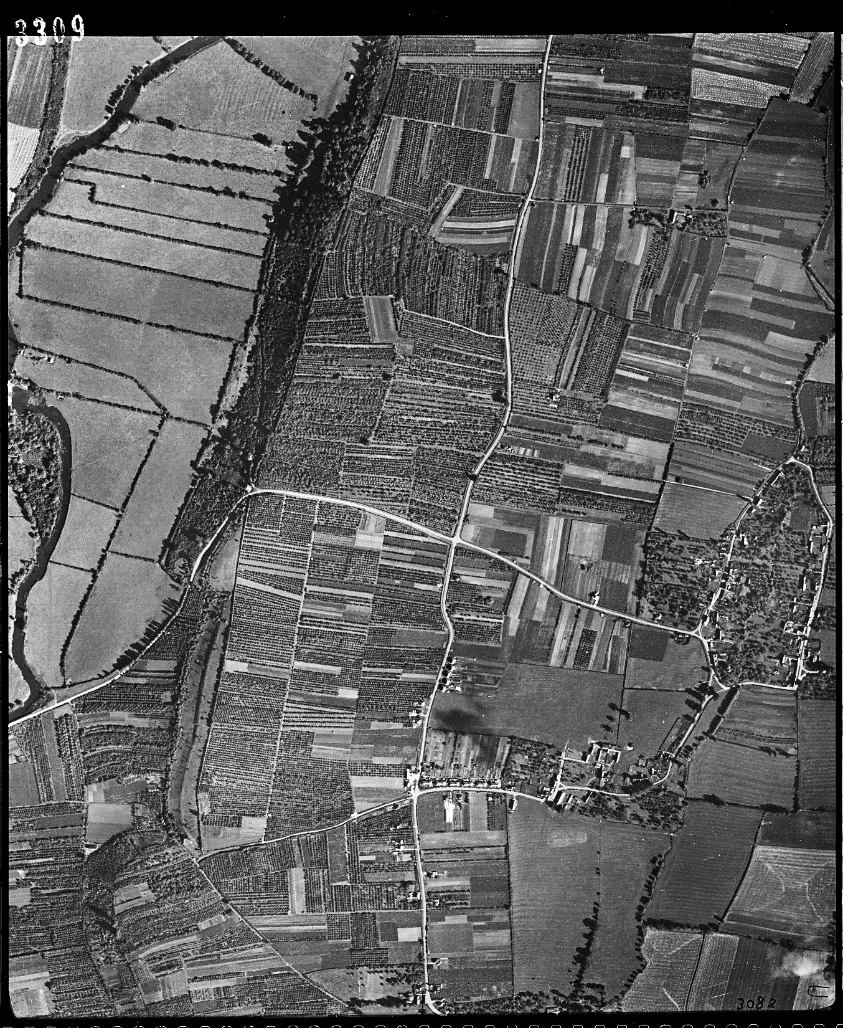
Shaping the landscape
North & Middle Littleton in 1946 (Historic England Archive – RAF Photography)
© LBG
Market gardens were long, narrow strips of land.
It was hard work as the growing and harvesting of plants was done by hand, with little help from machines.
Notes:
Market garden plots tended to be 1-2 acres in size. Fulltime market gardeners typically had 5-6 acres in total, spread out over a couple of plots on different soils. They worked the land by hand, which was no mean feat.
The aerial photo shows how market gardening heavy shaped the landscape by turning large arable and pasture fields (seen top left) into a patchwork of small, intensively worked strips.
Image (top right): A hand-pushed seed drill

Slide 6
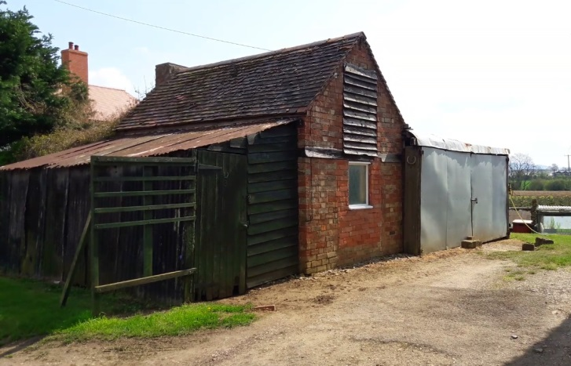
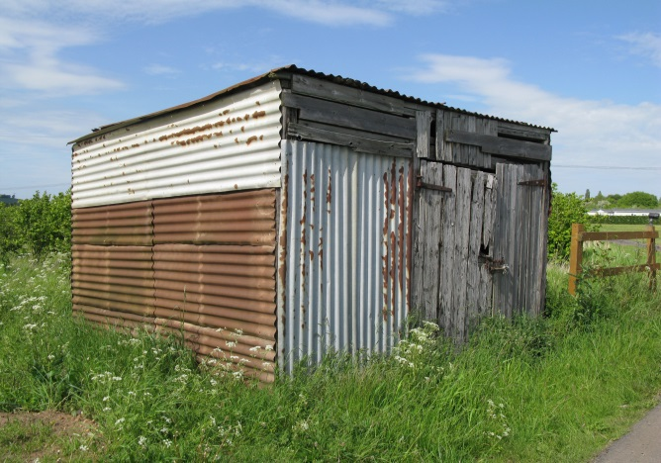
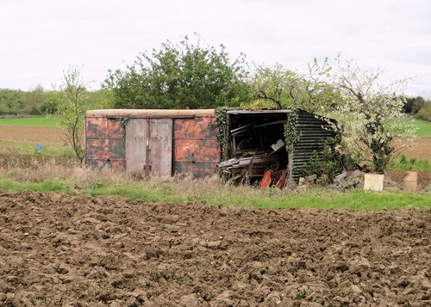
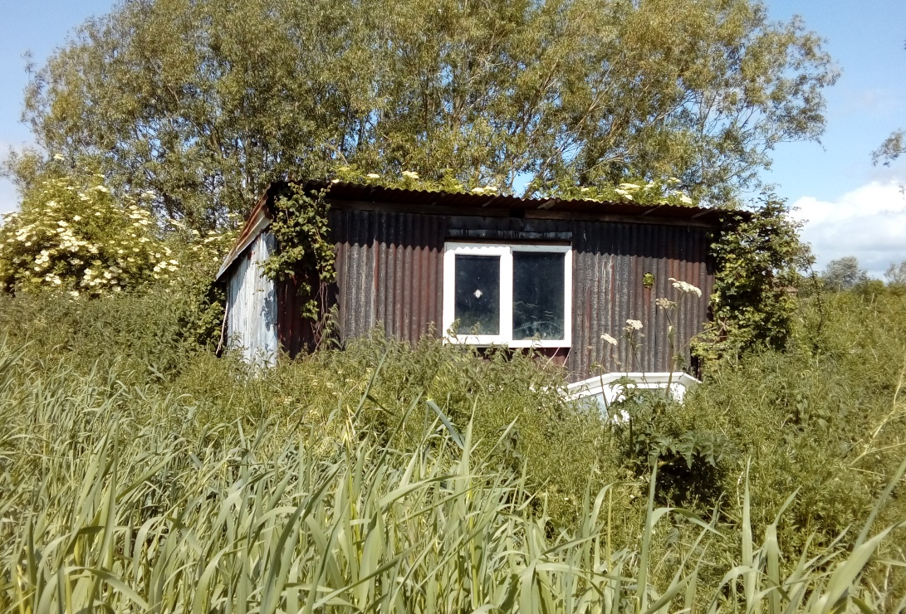
Market gardener’s hovel
Small buildings used by market gardeners once dotted the landscape – over 1500 were built in the Vale of Evesham.
They are known locally as ‘hovels’ (or ‘ovels) and are all slightly different.
Definition: hovel (noun)
Structure built by a market gardener on their land to store equipment and provide shelter from the weather. Most often built of wood and metal to the grower’s own design, although some are brick and were lived in by seasonal workers.
Notes:
Definition above has been created by the Market Gardening Heritage project, as there is no set definition of a hovel. If you ask someone to describe what they think of as a hovel it’ll often be slightly different to what the person before and person after says.
Images: Four hovels across the Vale (taken by the Market Gardening Heritage project and A. Wadsworth)

Slide 7
Travelling across the country
Food grown in the Vale of Evesham was sent by train to lots of towns and cities across the country.
After World War II, lorries began to replace trains as the main way to travel.
© M. Izod
Notes:
Produce grown in the Vale reached tables right across the country, from Aberdeen to Penzance and Aldeburgh over to Wales and into Ireland. Some of the main markets were Birmingham, Manchester and Covent Garden in London. The main means of transport was the railways, as they could get crops picked one day to a distant market by the next morning. However, towards the end of the industry’s heyday, lorry transport began to replace rail travel.
Background image: Baskets being taken off a dray (cart) and loaded on the train at Fladbury sidings (1920s) – copyright of M. Izod

Slide 8
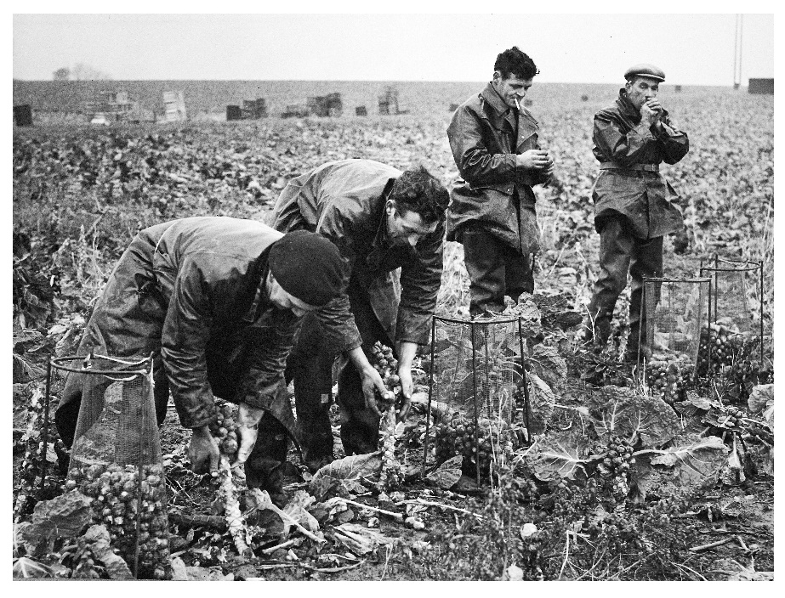
Whole community
Market gardening involved more than just growing – it involved blacksmiths, basket makers, transport companies, auctioneers, canning factories and many more.
© R. Haines
Notes:
It’s important to remember that market gardening was supported by a whole network of related trades, from basket makers to the local blacksmiths who made specialised tools (such as asparagus knives), auctioneers, transport companies and the jam and canning factories that ensured any surplus didn’t go to waste.
Image: Sprout picking in Cropthorne (1960s)

Slide 9
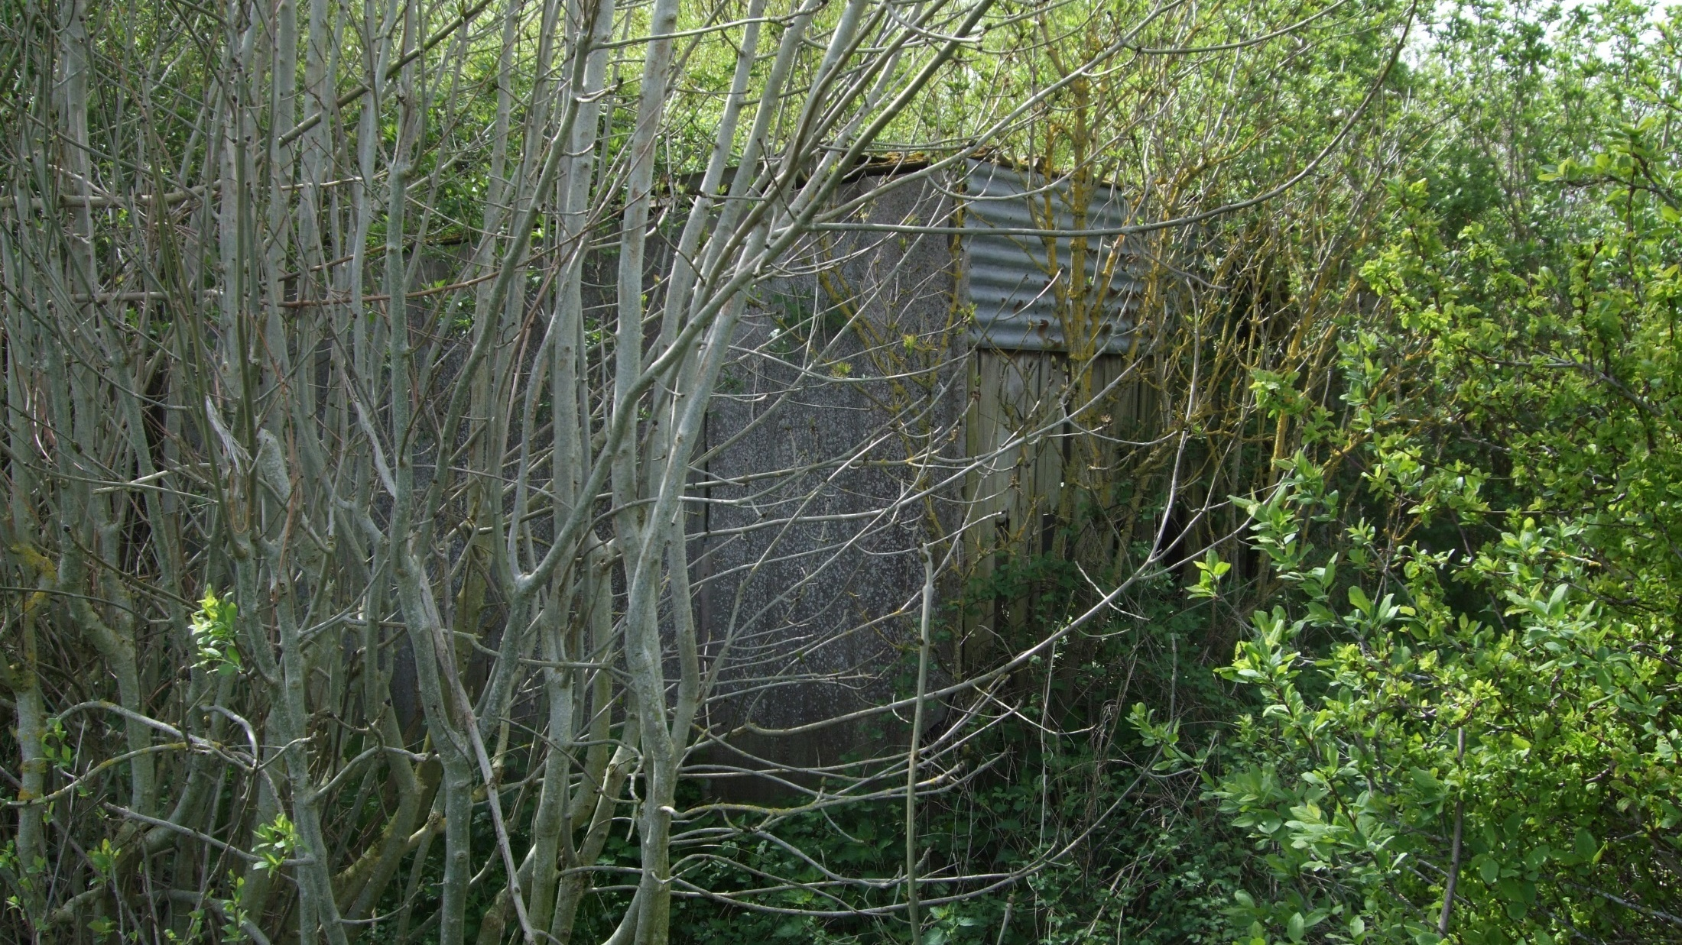
Today…
Notes:
From the 1960s, market gardening started to become less profitable and the industry gradually declined. Today, there are almost no traditional growers left in the Vale and the physical evidence, along with the knowledge and local memories are starting to disappear.
Image: Overgrowth hovel in Wickhamford

